Slide 1
Business model
Types of business Model

Slide 2
Meaning of business model
A business model is an outline of how a company plans to make money with its product and customer base in a specific market. At its core, a business model explains four things:
What product or service a company will sell
How it intends to market that product or service
What kind of expenses it will face
How it expects to turn a profit

Slide 3
Business Model Example
So, with this definition in mind, you might now be wondering: What is a business model example?
One popular example of a business model, as we’ll review shortly, is the subscription model—in which businesses charge a subscription fee (monthly, annually, etc.) for customers to access a service. Of course, this type of business model can be adjusted and customized for each individual business, but using Netflix as an example, let’s break it down based on the four points we outlined earlier:

Slide 4
Components of business model
Value proposition: A feature that makes your product attractive to your customers.
Target market: A specific group of consumers who would be interested in your product.
Competitive advantage: A unique feature of your product or service that can’t easily be copied by competitors.
Cost structure: A list of the fixed and variable expenses your business requires to function, and how they affect pricing.
Key metrics: The ways your company measures success.
Resources: The physical, financial, and intellectual assets of your company.
Problem and solution: Your target customers’ pain points, and how your company intends to meet them.
Revenue model: A framework that identifies viable income sources to pursue.
Revenue streams: The multiple ways your company can generate income.
Profit margin: The amount your revenue exceeds your business costs.

Slide 5
Types of business model
Manufacturing model
Retailing model
Freemium model
Online model
SAAS Model
Subsription model
Aggregator Model
Franchise model

Slide 6
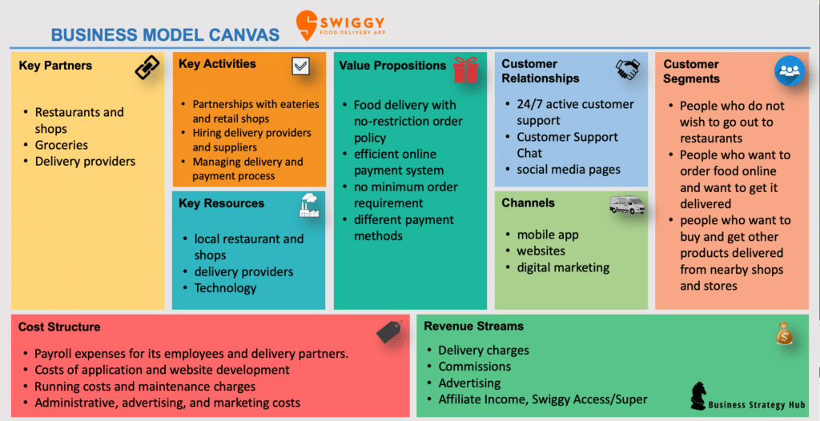
Business model

